Slide 1





The Challenge of Transactional and Transformational Leadership in Projects
Ana K. Tyssen, Andreas Wald, Patrick Spieth

Slide 2


Group Members
Aleena Abid
Abdur Rehman
Fatima Awais
Javaria Iqbal
Zoya Naveed
(2021-CS-146)
(2021-CS-157)
(2021-CS-175)
(2021-CS-185)
(2021-CS-201)

Slide 3


Introduction
The study examines two leadership styles—transactional and transformational—in temporary organizations like projects.
Temporary organizations differ from permanent ones due to their short-term nature, unique goals, and lack of traditional hierarchies.
Key leadership challenges include building trust quickly, fostering commitment, and managing uncertainty.
Transactional and Transformational leaderships
The paper develops a model to explore how these leadership styles impact team commitment and effectiveness in project settings.

Slide 4
Problem Statement
Leadership in temporary organizations, like projects, differs from permanent setups due to their short duration, unique goals, and lack of traditional hierarchies. While transactional and transformational leadership are well-studied in stable environments, their effectiveness in dynamic, short-term projects remains underexplored, highlighting the need to understand their impact on team commitment and success.

Slide 5
Literature Review
Topic | Key Insights | References
Temporary Organizations | Unique setups with short duration, specific goals, and no hierarchies. | Bakker (2010); Janowicz-Panjaitan et al. (2009)
Transactional Leadership | Task-focused, effective in stable, short-term projects with clear goals and responsibilities. | Bass (1990); Keller (2006)
Transformational Leadership | Inspires teams, fosters creativity, and excels in uncertain, innovative, and diverse environments. | Bass & Riggio (2006); Avolio et al. (2004)
Leadership Challenges | Leadership in projects struggles with authority gaps and diverse teams; research is often industry-specific. | Zimmerer & Yasin (1998); Chen et al. (2004)
Research Gap | Limited study on leadership styles in dynamic, temporary setups; effectiveness remains unclear. | Müller & Turner (2007)

Slide 6

Methodology
Research Methods
Surveys
Case Studies
Literature Review
Team members shared their experiences with different leadership styles.
Researchers analyzed real projects to understand how leadership impacted results.
Existing research was reviewed to help create a clear framework for the study.

Slide 7
Methodology
(contd.)
Challenges Addressed
Short Time Frames
Team Diversity
Uncertainty
Leaders don’t have much time to build trust within the team.
Projects often involve unclear goals or unexpected problems.
Leaders must manage team members with different skills and backgrounds.

Slide 8
ANALYSIS
A. Characteristics of a temporary Organization
Limited Duration
Unique Outcomes
Missing Hierarchies
High Uncertainty and Risk
Heterogeneous Teams

Slide 9
ANALYSIS
C. Integration of Leadership Theories
Transactional Leadership
Best for projects with well-defined goals and responsibilities.
Focuses on structured exchanges (e.g., rewards for performance).
Transformational Leadership
Ideal for projects with high uncertainty or novelty.
Inspires creativity, fosters commitment, and motivates teams.
Effective in environments with missing hierarchies or diverse teams.

Slide 10
ANALYSIS
D. Research Model and Propositions
The authors present a conceptual model linking:
Project characteristics (duration, novelty, uncertainty, etc.),
Leadership behaviors (transactional and transformational), and
Outcomes such as team commitment and performance.
Key Propositions:
Transactional leadership thrives in clear, stable project environments.
Transformational leadership excels in ambiguous, uncertain, and novel contexts.
Transformational leadership is critical for fostering team cohesion and commitment in temporary organizations.

Slide 11
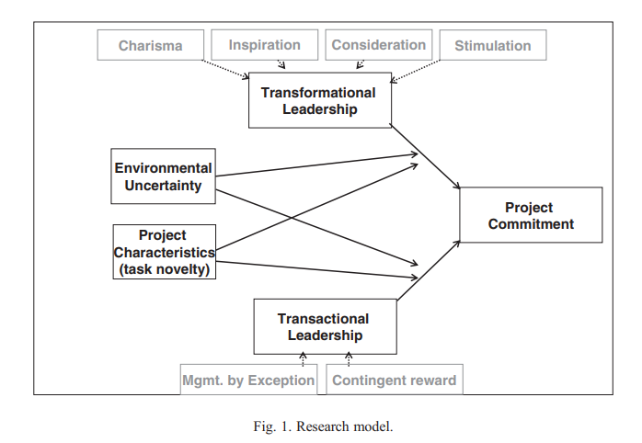
Framework
Overview of the Research Model
The model shows how leadership styles influence project commitment in temporary organizations.
Key Components:
Project Characteristics: Task novelty, limited duration, team diversity.
Leadership Styles: Transactional (structure) and Transformational (inspiration).
External Influences: Environmental uncertainty shapes leadership needs.

Slide 12
Framework
(contd.)
Connections in the Research Model
Leadership and Commitment
Environmental Uncertainty
Commitment Outcomes
Transactional Leadership:
Effective when goals and responsibilities are well-defined, particularly in short-duration projects.
Transformational Leadership:
Promotes long-term vision, creativity, and engagement, crucial in uncertain and novel project environments.
Acts as a catalyst for transformational leadership, driving higher commitment and innovation.
Both leadership styles positively influence followers’ project commitment, with transformational leadership having a stronger effect during uncertainty.

Slide 13
Findings
Leadership Insights
Research Framework
Model Testing
Transactional
Variables
Methods
Goal clarity, structured approach, short-duration.
Task novelty, goal clarity, duration, heterogeneity.
Surveys, MLQ, questionnaires.
Validation
Transformational
Leadership
Empirical analysis, measurable outcomes.
Uncertainty, creativity, follower commitment
Intellectual stimulation, charisma, rewards.

Slide 14
Conclusion
1. Key Takeaways: Leadership effectiveness in temporary organizations is strongly influenced by project characteristics. Transactional and transformational leadership styles serve distinct purposes but can complement each other depending on the project's needs.
2. Practical Implications: Project managers must evaluate project traits to tailor leadership strategies effectively. Emphasizing clear goals, promoting creativity, and inspiring team commitment are critical for success.
3. Path Forward: The study highlights the need for extensive empirical research to validate the proposed model and refine its hypotheses, enabling better insights into leadership dynamics in temporary settings.

Slide 15

Thank You

